Slide 1
Web Application Development ISCG7420 Introduction to Web Development
School of Computing, Electrical and Applied Technology

Slide 2
Outlines
Django Model
Django Model field types
Django Field options
Relationships
Model methods
Simple Blog Models

Slide 3
Models
A model is the single, definitive source of information about your data. It contains the essential fields and behaviors of the data you’re storing. Generally, each model maps to a single database table.

Slide 4
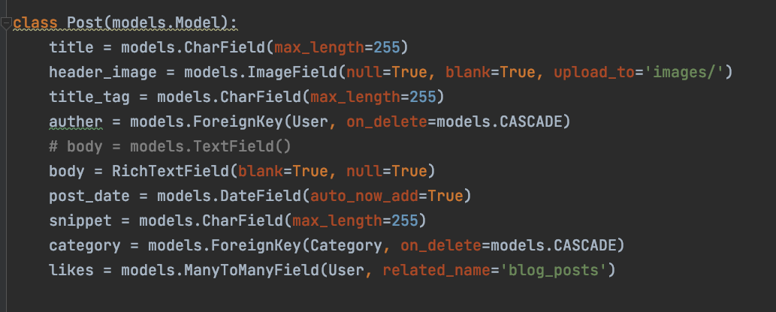
Quick example

Slide 5
Django Model field types
https://docs.djangoproject.com/en/4.0/ref/models/fields/#field-types

Slide 6
Django Field options
max_length CharField
null -> True/False
blank -> True/False
choices -> choose from a list
default -> give a default value
primary_key -> use this for primary key instead of using id for primary key, it has True/False
unique -> True/False

Slide 7
Relationships
ForeignKey
ManyToManyField
OneToOneField

Slide 8
Model methods
__str__()
get_absolute_url()

Slide 9
Predefined model methods
save()
filter()
exclude()
order_by()
https://djangobook.com/django-tutorials/mastering-django-advanced-models/

Slide 10
Custom methods
def full_name(self):
"Returns the person's full name."
return '%s %s' % (self.first_name, self.last_name)

Slide 11
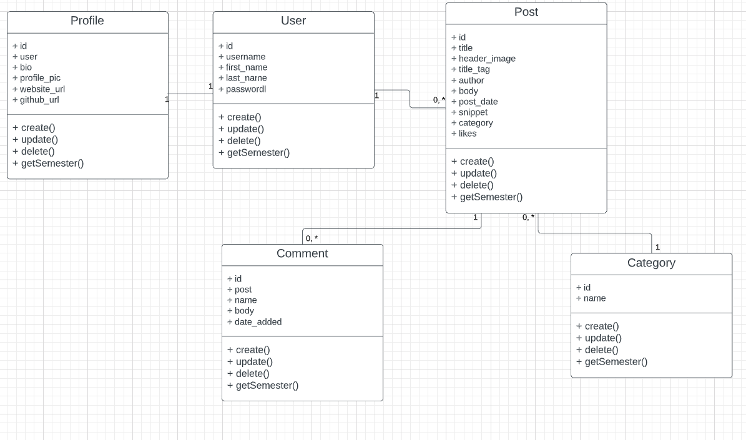
Simple Blog Models

